Slide 1
Python Basic Operators
Life Choices Coding Academy 2020

Slide 2
Learning Outcome
By the end of this section, learners should be able to:
Name python operators.
Make use of Python operators.

Slide 3

Operators
What are operators in Python?
Python support the following types of operators:
- Arithmetic operators
- Comparison operators
- Logical operators
- Bitwise operators
- Assignment operators
- Identity operators
Notes:
Operators are special symbols in Python that carry arithmetic or logical computation
The value that the operator operates on is called the operand.
Some operators are special operators because they do not alter the value of the operand.
We will go briefly discuss each on the next slides.

Slide 4
Arithmetic Operators
Arithmetic operators are used to perform mathematical operations like addition, subtraction, multiplication etc.
Notes:
We use (+) to perform an addition for example.
Demonstrate other arithmetic operations in the class.
Demonstrate importance of arithmetic operators with either a bank or gaming program.

Slide 5
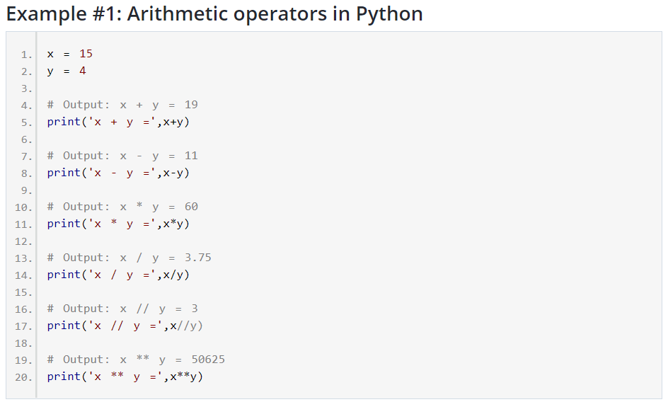
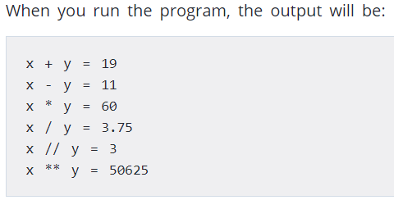
EXAMPLE:
Notes:
Explain what floor division is - The division of operands where the result is the quotient in which the digits after the decimal point are removed. But if one of the operands is negative, the result is floored, i.e, rounded away from zero (towards negative infinity)

Slide 6
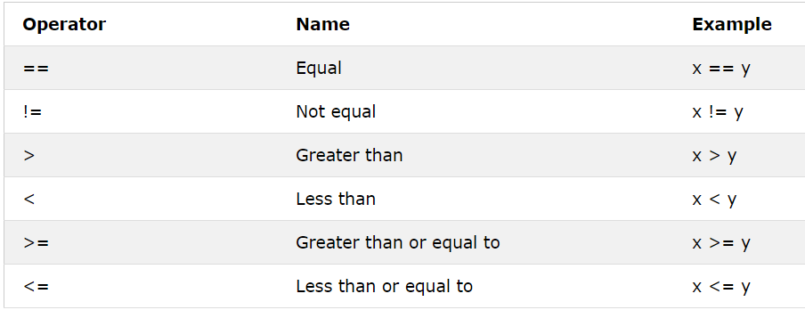
Comparison operators
Comparison operators are used to compare values. It either returns True or False depending on the condition.
Notes:
Demonstrate other comparison operators in class using the interpreter.

Slide 7
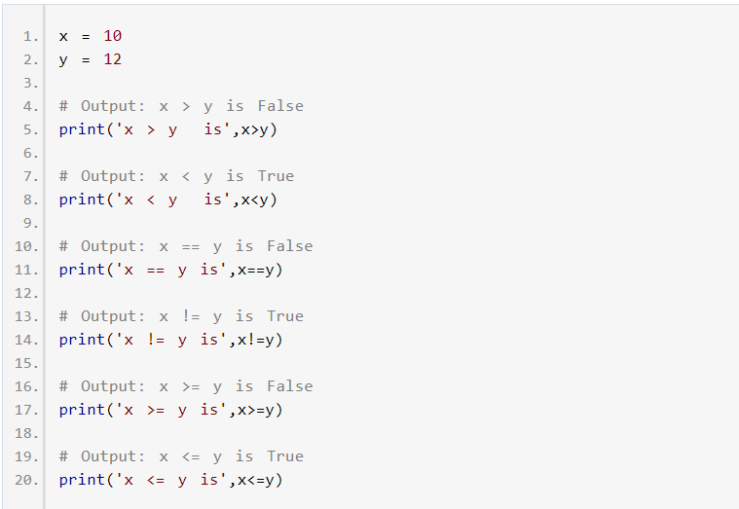
Notes:
Demonstrate comparison operators in class.

Slide 8
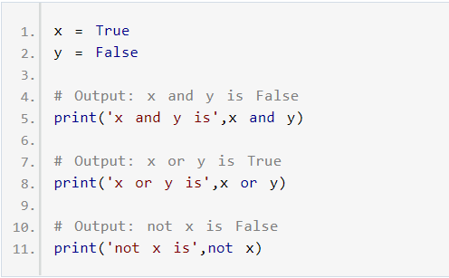
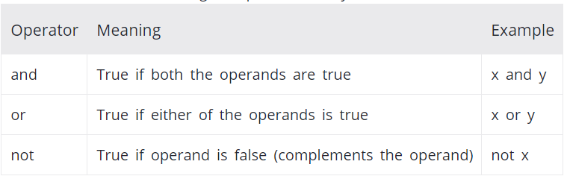
Logical Operators
Logical operators are the and, or, not operators.
Notes:
and – returns True only if both operands are true.
or – returns True when one or both of the operands are true
not – negates the truth value of a single operand. In other words, True becomes False and vice versa.

Slide 9
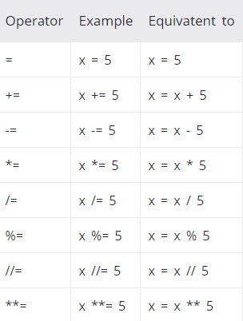
Assignment Operators
Are used in Python to assign values to variables.
Assignment operators use(+=, - = , *=, /= , etc.)
Notes:
Assignment operators are used in Python to assign values to variables.
a = 5 is a simple assignment operator that assigns the value of 5 on the right to the variable a on the left. There are various compound operators in Python like a += 5 that adds to the variable and later assigns the same. It is equivalent to a = a + 5.

Slide 10
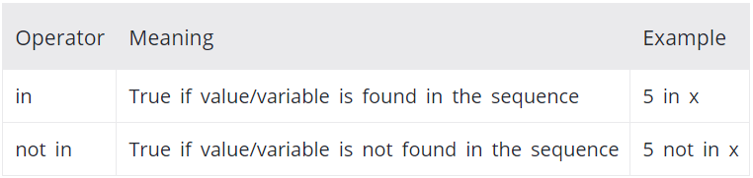
Membership Operators
Test for membership in a sequence such as lists, strings or tuples
There are two membership operators.
in
not in
- It gives results based on the variable present in the specified sequence

Slide 11
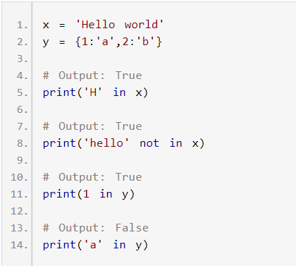
Membership Operators
Notes:
Built the example together with the students.
Have an example showcasing how easy it is to find an element in a list.
Here, 'H' is in x but 'hello' is not present in x (remember, Python is case sensitive). Similarly, 1 is key and 'a' is the value in dictionary y. Hence, 'a' in y returns False.

Slide 12
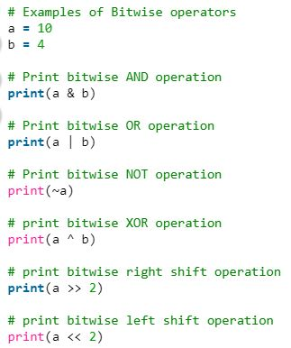
Bitwise Operators
Bitwise operators acts on bits and performs bit by bit operation.
Notes:
Output:
0
14
-11
14
2
40
Demonstrate real world usage of bitwise operators. Find some relevant examples and interview questions.
Have a look at this relevant interview question on usage of bitwise operators. Time and complexity metters.

Slide 13
Exercise time :)

Slide 14
Complete the all exercises which is available on the link below:
https://www.w3schools.com/python/exercise.asp?filename=exercise_operators1

